Slide 2
Usage of text in Multimedia
Definition of Text
• Text is words and symbols in any form, spoken or
written, are the most common system of
communication.
• Text is used in most Multimedia applications.
• With multimedia technology, text can be combined
with other media in a powerful and meaningful way to
present information and express moods.
• Text is the easiest to manipulate

Slide 3
Usage of text in Multimedia
Text Elements
• Text elements can be categories into:
– Alphabets characters: A – Z
– Number: 0 – 9
– Special characters: . , ; : ‘ “
– Symbols: @ # $ & *

Slide 4
Usage of text in Multimedia
Text Usages
• Heading / Title
• Bullet / list
• Paragraph
• Scrolling text
• Navigation
• Text as graphics

Slide 5

Text Usages
Text as graphic
Heading
Navigation
Paragraph
5

Slide 6
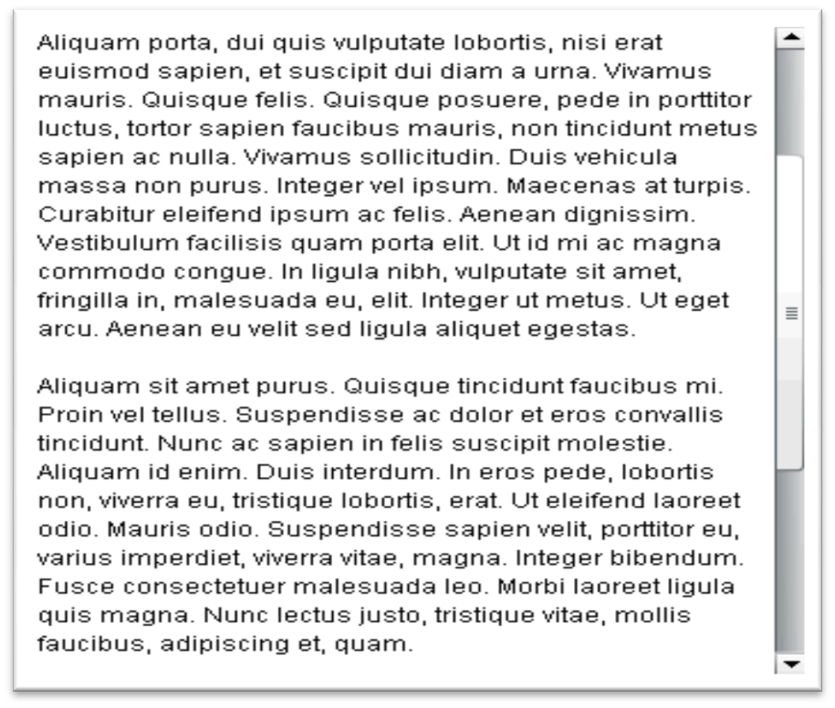
Usage of text in Multimedia
Scrolling text

Slide 7
Usage of text in Multimedia
Font
A design for a set of characters.
A collection of characters of a single size and style belonging to a particular typeface family.
There is some basic consistency of look that makes the individual characters, regardless of size and style variations, part of the same family.

Slide 8
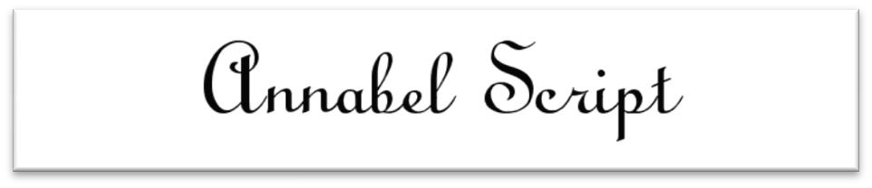
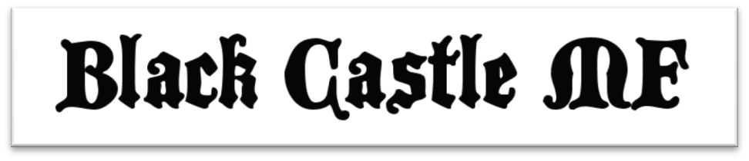
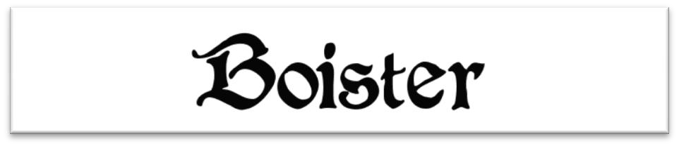
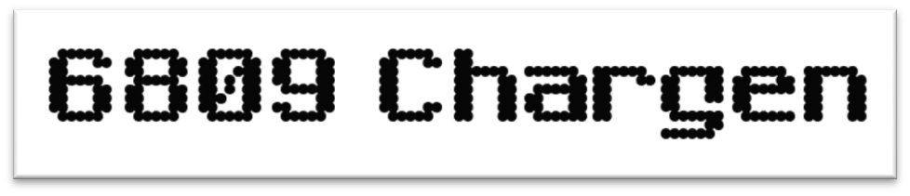
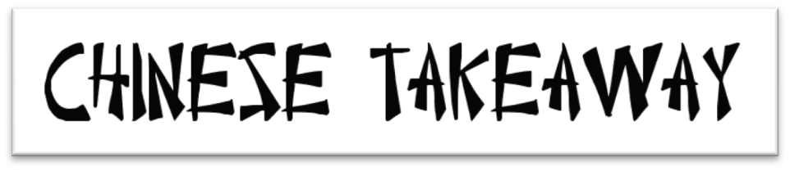
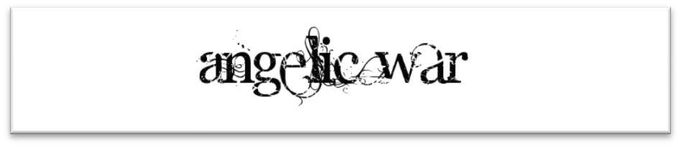
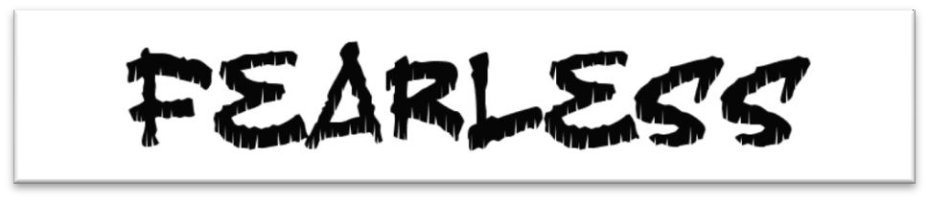
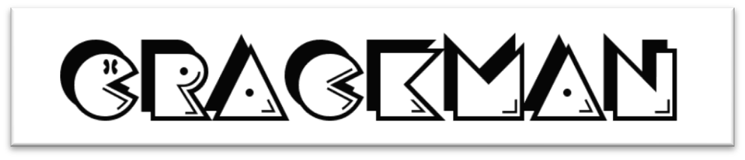
Usage of text in Multimedia
Font

Slide 9

Usage of text in Multimedia
Font Size
The size of a font, typically represented in points (pt).
The font size is the distance from the top of the capital letters to the bottom of the "descenders" in letters such as "g" and "y.“

Slide 10
Font Size
Font Size | Example
8 point | Text
12 point | Text
24 point | Text
72 point | Text

Slide 11
Font Size
Users may have difficulty reading small text, seeing small objects or targeting small icons and controls with a mouse.
Small fonts can cause eye-strain and make reading difficult or impossible for many users.
Screen elements with fixed sizes may be too small on high-resolution displays or exceed the screen size on small, hand-held devices.

Slide 12
MMGD0203 Multimedia Design
Font Style
Refers to whether text is bold, italicized, underlined, or any combination of the three
The term font style refers to the particular style of textual characters.
Styles are usually standard.
Bold Underline italic

Slide 13
Font Style
MMGD0203 Multimedia Design
Use bold fonts for emphasis, to highlight important points.
Multimedia is media and content that uses a combination of different content forms.
Multimedia includes a combination of text, audio, still images, animation, video, or interactivity content forms.

Slide 14
Font Style
Whole paragraphs of text set in bold type are hard to read.
Multimedia is media and content that uses a combination of different content forms. Multimedia includes a combination of text, audio, still images, animation, video, or interactivity content forms.
Multimedia is media and content that uses a combination of different content forms. Multimedia includes a combination of text, audio, still images, animation, video, or interactivity content forms.

Slide 15
Font Style
MMGD0203 Multimedia Design
In some instances it is useful to readers to have titles, proper names, or key terms in a manual within a block of copy highlighted with bold for ease in scanning.
Definition of Multimedia
Multimedia is media and content that uses a combination of different content forms. Multimedia includes a combination of text, audio, still images, animation, video, or interactivity content forms.

Slide 16
Font Style
MMGD0203 Multimedia Design
Use italics to emphasize small amounts of text within a block of text.
Avoid long passages in italics.
It is harder to read than normal roman faces.
Definition of Multimedia
Multimedia is media and content that uses a combination of different content forms.

Slide 17
Font Style
When they are not a common part of your language, italicize foreign words and phrases.
In computing, a mouse (tetikus) is a pointing device that functions by
detecting two-dimensional motion relative to its supporting surface.

Slide 18
Font Style
Underlines are appropriate for section headings and some bibliographical notations.
In web browsers, default settings typically distinguish hyperlinks by underlining them.

Slide 19
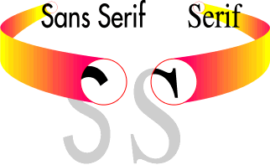
Font Categories
Fonts can be characterized as
Serif
Sans serif
Decorative

Slide 20
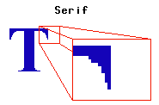
MMGD0203 Multimedia Design
Font Categories - Serif
Serif characters have a little "flag" or decoration at the end of the letter stroke.

Slide 21
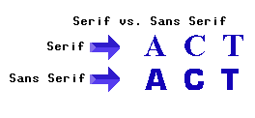
MMGD0203 Multimedia Design
Font Categories – San Serif
Sans Serif (sans is French for "without") characters don't have these decorations.

Slide 22
MMGD0203 Multimedia Design
Font Categories – Decorative
Used to decorate, embellish, and beautify a text.
With the help of decorative fonts any informal passage can become more reader-friendly: it will quickly capture attention of the readers and make a text easier to perceive, unusual, and fascinating.

Slide 23
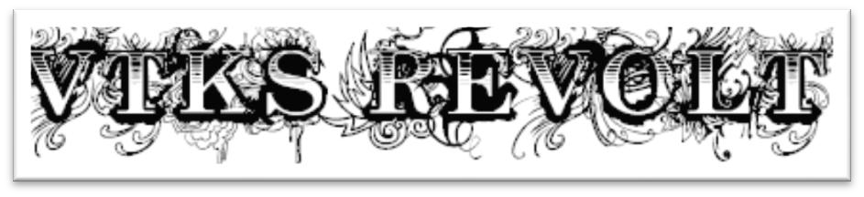
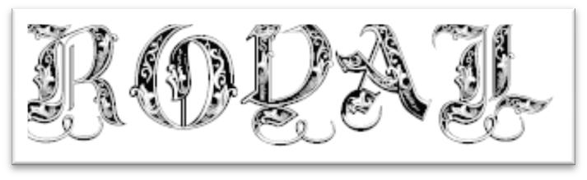
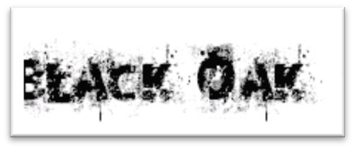
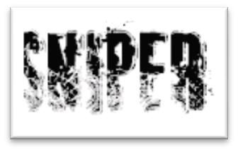
MMGD0203 Multimedia Design
Font Categories – Decorative

Slide 24
MMGD0203 Multimedia Design
Paragraph Alignment
The arrangement of text relative to a margin.
Four types of alignment:
Flush left
Flush right
Centered
Justified

Slide 25
MMGD0203 Multimedia Design
Paragraph Alignment – Flush Left
The text is aligned along the left margin, also known as ragged right.
In English and most European languages where words are read left-to- right, text is often aligned ‘flush left’, meaning that the text of a paragraph is aligned on the left-hand side with the right-hand side ragged.
This is the default style of text alignment on the World Wide Web for left-to-right text.
Words and symbols in any form, spoken or written, are the most common system of communication. They deliver the most widely understood meaning to the greatest number of people – accurately and in detail. Because of this, they are vital elements of multimedia menus, navigation systems, and content.

Slide 26
Paragraph Alignment – Flush Right
MMGD0203 Multimedia Design
The text is aligned along the right margin, also known as ragged left.
In other languages that read text right-to- left, such as Arabic and Hebrew, text is commonly aligned ‘flush right’.
Additionally, flush-right alignment is used to set off special text in English, such as attributions to authors of quotes printed in books and magazines, and is often used when formatting tables of data.
Words and symbols in any form, spoken or written, are the most common system of communication. They deliver the most widely understood meaning to the greatest number of people – accurately and in detail. Because of this, they are vital elements of multimedia menus, navigation systems, and content.

Slide 27
Paragraph Alignment - Centered
MMGD0203 Multimedia Design
Text is aligned to neither the left nor right margin; there is an even gap at the end of each line.
This is often used for the title of a
work, and for poems and songs.
As with flush-right alignment, centered text is often used to present data in tables.
Words and symbols in any form, spoken or written, are the most common system of communication. They deliver the most widely understood meaning to the greatest number of people – accurately and in detail. Because of this, they are vital elements of multimedia menus, navigation systems, and content.

Slide 28
MMGD0203 Multimedia Design
Paragraph Alignment - Justified
Text is aligned along the left margin, and letter- and word-spacing is adjusted so that the text falls flush with the right margin, also known as full justification.
Words and symbols in any form, spoken or written, are the most common system of communication. They deliver the most widely understood meaning to the greatest number of people – accurately and in detail. Because of this, they are vital elements of multimedia menus, navigation systems, and content.

Slide 29
Working with Text
MMGD0203 Multimedia Design
Following are some considerations and guidelines to keep in mind when working with text :
Be Concise
Use Appropriate Fonts
Make it Readable
Consider Type Styles and Colors
Use Restraint and be Consistent

Slide 30
Working with Text - Be Concise
MMGD0203 Multimedia Design
Text should be kept to a minimum unless the application includes a great deal of reference material.
Reading volumes of text on a computer screen is
difficult and tiring.
From a design standpoint, text should fill less than half the screen

Slide 31
Working with Text - Use Appropriate Fonts
Fonts are useful in focusing attention on certain test on the screen, enhancing readability, setting a tone (serious, lighthearted), and projecting an image (progressive, conservative).
When choosing a font, always consider the objectives and the audience.

Slide 32
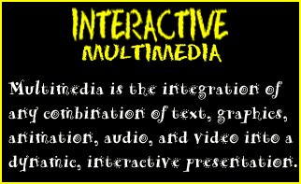
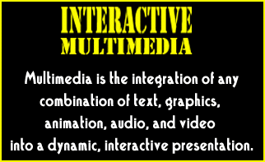
Working with Text - Use Appropriate Fonts
MMGD0203 Multimedia Design
This may be appealing to a younger audience because their childlike or whimsical look.
This are more appropriate
for a formal look.

Slide 33
Working with Text - Make it Readable
Although a decorative font maybe attractive but it may also hard to read.
The size of text depends on the application.
Heading and subheadings are used to attract attention and provide the user with quick identification of the screen contents, while text blocks provide the substance.

Slide 34
Working with Text - Make it Readable
MMGD0203 Multimedia Design
Suggested guidelines are as follows :
Headings Subheadings Text blocks
14 to 48 point
Half the heading size 10 to 12 point

Slide 35
Working with Text - Make it Readable
This example of size of lettering shows the effect size has on readability
This example of size of lettering shows the effect size has on readability
This example of size of lettering shows the effect size has on readability
This example of size of lettering shows the effect size has on readability
This example of size of lettering shows the effect size has on readability

Slide 36
Working with Text - Consider Type Styles and Colors
MMGD0203 Multimedia Design
Three common type styles are bold, italic, and underline.
These styles are often used for emphasis in print
materials.
In multimedia applications, however, there are more often used to indicate hypertext, or hot words.

Slide 37
Working with Text - Consider Type Styles and Colors
Contrast between the lettering and background also is a very important factor in legibility and readability.
How easy is it to read this written information
How easy is it to read this written information
How easy is it to read this written information
How easy is it to read this written information

Slide 38
Working with Text - Use Restraint and be Consistent
Although it may be tempting and certainly easy to use various typefaces, sizes, and styles, it is important to exercise restraint.
Be careful to avoid a busy and difficult to read design resulting from too many fonts and type styles on one screen.
In addition, try to maintain consistency in the use of text.

Slide 39
Tutorial
Define TEXT.
Why text element widely used in multimedia applications?
What are the four categories of text? Give examples.
Explain any four examples of text usage in Multimedia.
Define FONT and FONT SIZE.
Explain the difference between SERIF and SANS SERIF font.
Give three examples of font style.
There are four types of paragraph alignment.
Describe five guidelines when working with text in Multimedia application.
Why do decorative fonts are only suitable to be used for header or title but not suitable for paragraph?

Slide 40
Reference and text books:-
TEXT BOOKS
Tay Vaughan, “Multimedia making it work”, Tata McGraw-Hill, 2008.
Rajneesh Aggarwal & B. B Tiwari, “Multimedia Systems”, Excel Publication, New Delhi, 2007.
Li & Drew, “Fundamentals of Multimedia”, Pearson Education, 2009.
REFERENCE BOOKS
Parekh Ranjan, “Principles of Multimedia”, Tata McGraw-Hill, 2007
Anirban Mukhopadhyay and Arup Chattopadhyay, “Introduction to Computer Graphics and Multimedia”, Second Edition, Vikas Publishing House.

Slide 41
Any query ??

Slide 42

Thank you

